Slide 1
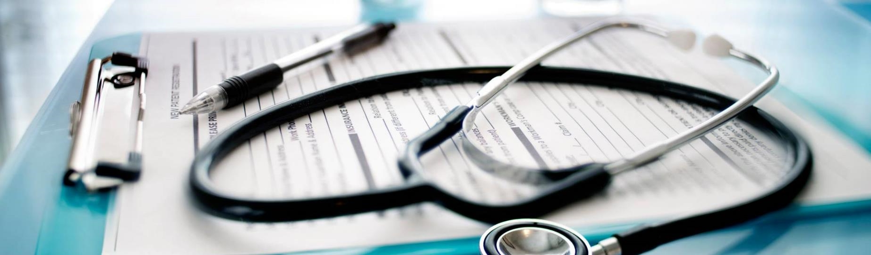

Fast entry of e-Rx
Balaji Muralidharan and Kishen Giri.C

Slide 2
Business scenario
Appointment
Insurance Verification
Service provided to the patient
Medical documentation and EMR
Notes:
Physicians use EMR software to enter all details about the patient. They also document the medications prescribed, i.e., enter the prescription
Entry of a prescription in a software takes much more time than handwritten prescription, but data entry in software enables prescription data to be available to pharmacy and insurance companies and lends itself to research and analytics.

Slide 3
Prevailing limitations
Consumes time and man power In capturing the information in EMR Software.
Additional cost incurred in the process of updating in EMR software.
Incorrect documentation in electronic health records causing denial with the payer.
Notes:
Resource utilization in updating the information from prescription to EMR software
There are data entry error which results in payer denial and incurs additional cost in billing claims to payer

Slide 4
Why this product
Cost efficient
Intuitive UI
Real-time data updation
Curtail Human error
Resource optimization
Analytical study
Notes:
Inter

Slide 5
Solution Description
An Application based UI for Prescription
A continuous learning handwriting recognition application based on RNN, ML, DL.
Prescription for one drug will take less than 45 seconds
Structured database for norm code detection and data pipeline to EMR / EHR
Assistive speech recognition for medicine prescription
Restricted access with user authentication

Slide 6
Challenges and Solutions
Challenges
Fitting the solutions with the providers current practice.
Making the solution cost effective.
Handwriting recognition
PHI Security
Solutions
Providers current practice is not disturbed.
Since this business solution is application based. The cost is much effective than making a IOT device.
cursive handwritten medical words recognition system using neural network, ML, DL.
Since the application is on with the Provider office/Facility server, the saved PHI is safe and secure. Only authorised can access after authentication.

Slide 7
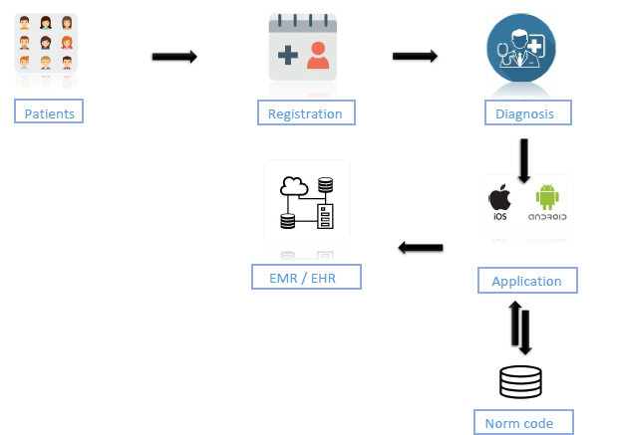
Process Model

Slide 8
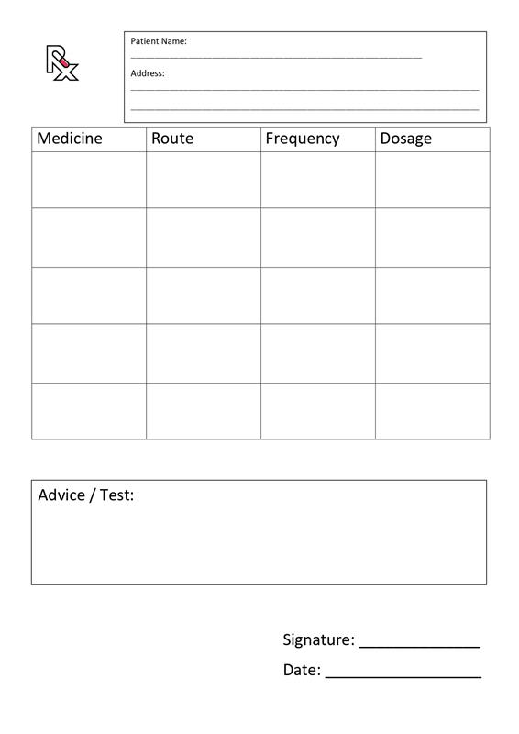
Application UI
Table Description
Column Name | Variable type
Medicine | Varchar
Route | Varchar
Frequency | Varchar
Dosage | Varchar
Advice/Test | Image / BLOB

Slide 9
Data from the database will be used for analytics
Connecting the dots to clinical optimization
Appropriate data distribution
Promoting prevention.
Identifying Readmission Risks.
Significant Opportunity for clinical optimization.
Other analytical opportunities

Slide 10
Reference:
Article on cursive handwritten medical words recognition system- https://www.nature.com/articles/s41598-022-07571-z
Research Thesis on handwriting by MIT USA - https://dspace.mit.edu/bitstream/handle/1721.1/128575/1220877663-MIT.pdf?sequence=1&isAllowed=y
Handwriting Recognition System --https://github.com/0x454447415244/HandwritingRecognitionSystem
Echo 2 Smart pen - https://us.livescribe.com/

Slide 11

Thank you

